Slide 1
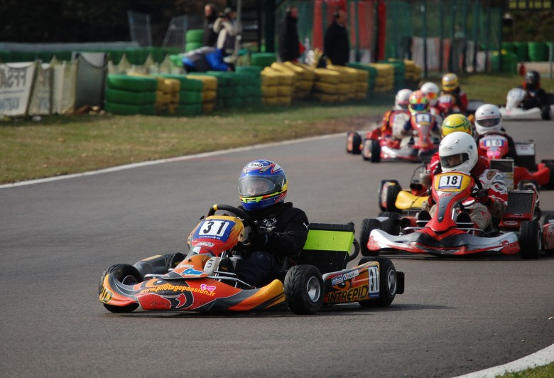

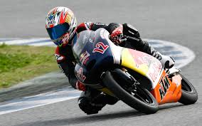
Make the most of it

Slide 2



FunSports
Fun at it’s best

Slide 3
Background information
Kenya is a great sporting nation and is probably best known for her award-winning athletes who scoop several awards at the Olympics and other international sporting events worldwide. However, despite athletics being almost synonymous with Kenyan sports, there is a lot more on offer to the sporting enthusiast.

Slide 4
Problem statement
Need to bond with family and friends.
Fun events to engage in over the weekends.

Slide 5
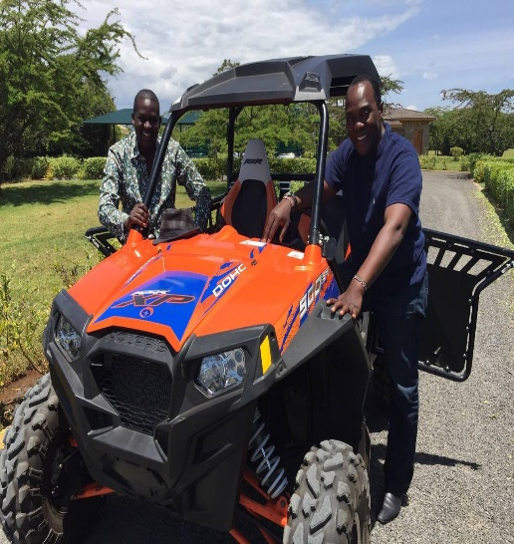
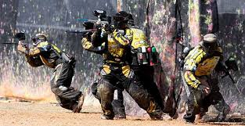
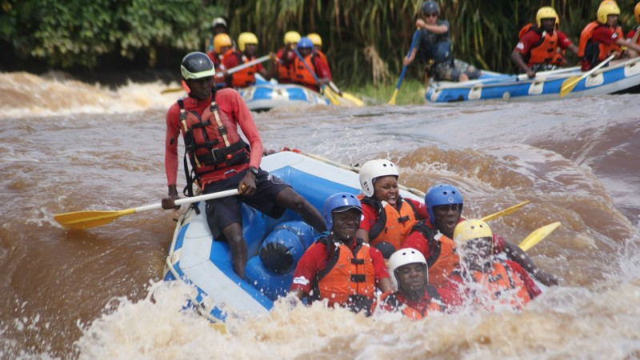
Categories
Motor Racing
Bike Racing
Paint Ball
Water Rafting

Slide 6
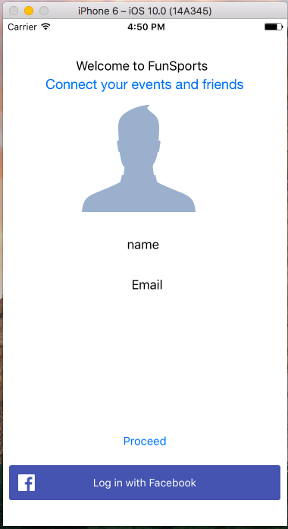
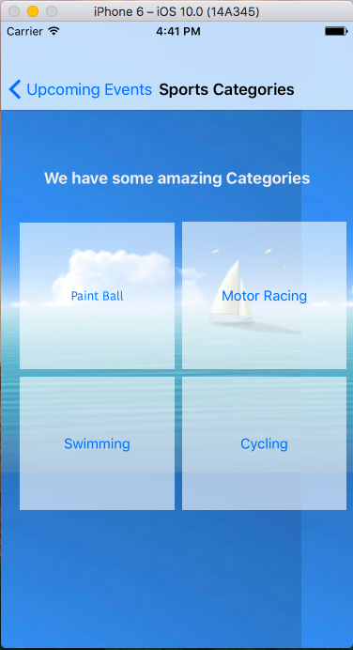
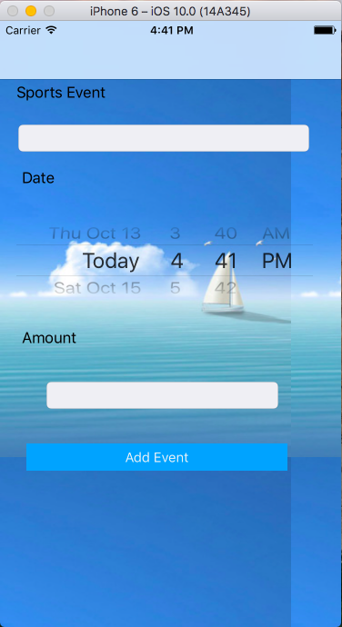
Screenshots

Slide 7


